Slide 1

This weeks lesson
By Saimye Dennis

Slide 2
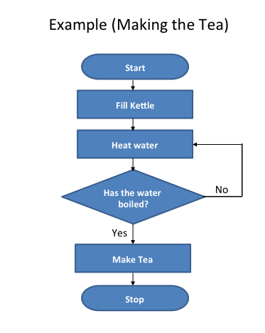
Flowcharts
A fundamental you can use to go through steps in a orderly fashion .
Starts with an oval .
Next we have a process step in which a process step is whatever you are having your code do. which the shape is a rectangle .
Use an input / output function which would be a parallelogram to tell the user something or to ask the user something .
You also have decisions in this process in which you can get yes’s and no’s which this can use if , else if and else conditions. This uses a diamond.
Ends with an oval .

Slide 3
Why should we use flowcharts
Flowcharts are a great way to help plan out your code
Also helps you understand exactly what your code needs or how to code it
Flowcharts help programmers identify a potential problem
Efficiency Increase

Slide 4
How can a flowchart save you time
Identifies problems
Lets you know steps to do your project or work in
A lot of coding can be winging it and just following your thoughts but with this you have a gameplan.

Slide 5
Some cons of flowchart
May be time consuming
Difficult for new comers
Making changes can be a problem
Not really meant for man to computer scenarios

Slide 6
USE FLOWCHARTS
BUT IN THE END THE PROS OUT WEIGH THE CONS
WORKS PHENOMENALLY
THIS HELP YOUR COMMUNICATION SKILLS BLOSSOM
Now that you know how to use flowcharts go out and make one.

